Slide 1
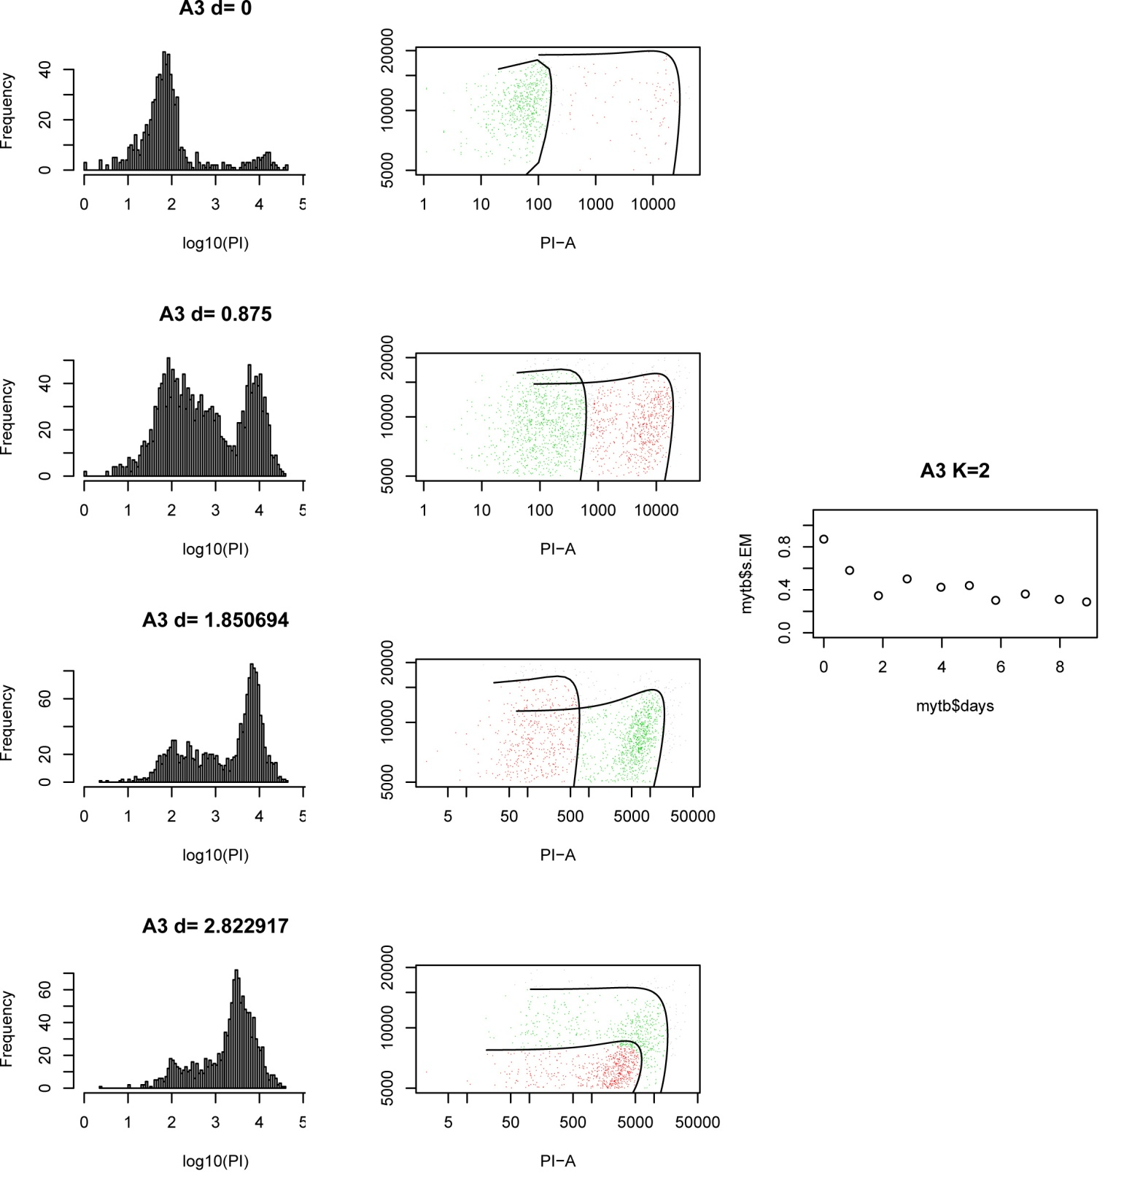
Measure CLS by Flow Cytometry

